Slide 1
How to WRITE A Research PAPER/ Poster

Slide 2
Contents
What is Research
How Research is Executed
What is Research Paper
Research Paper Vs Report Writing
What is Poster
Paper vs. Poster
Types of Research Paper
DO’s and Do not’s
Referencing

Slide 3
What is Research
Systematic Investigation into and study of materials, sources, etc, in order to establish facts and reach new conclusions
An endeavour to discover new or collate old facts etc by the scientific study of a subject or by a course of critical investigation
[Oxford Concise Dictionary]

Slide 4
What is Research
Research is what we do when we have a question or a problem we want to resolve
We may already think we know the answer to our question already
We may think the answer is obvious, common sense even
But until we have subjected our problem to Rigorous Scientific Scrutiny, our 'knowledge' remains little more than guesswork or at best, intuition

Slide 5
How Research is Executed
First priority is to formulate your question
Then figure out how you are going to answer it
How have others answered it?
How does your proposal fit in with what others have done?
How will you know when you have answered it?
Then you can present your answer
Research Process
Statement of the problem
Literature review
Choice of research method
Design of study
Data collection
Analysis of data
Write-up

Slide 6
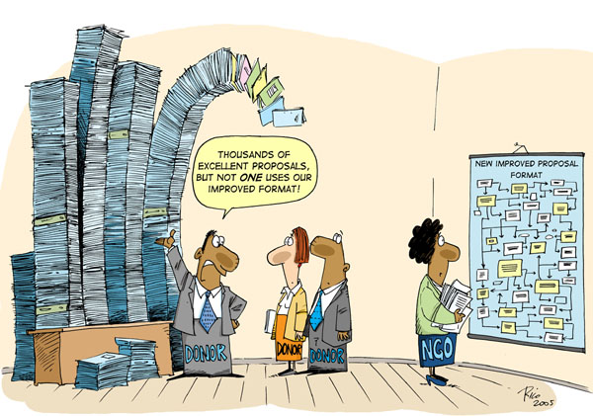

Slide 7

The Problem is Not Writing

Slide 8
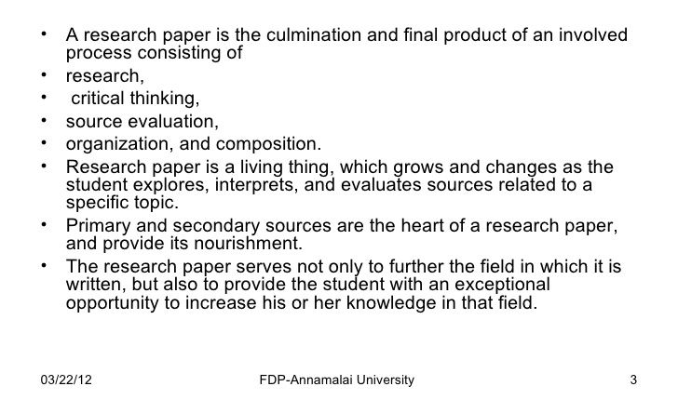
What is a Research Paper

Slide 9

Component of Research Paper
Title
Abstract
Introduction
Literature Review
Methodology
Results
Discussion/Conclusion
References/Bibliography

Slide 10
Research Paper Vs Report Writing
Research Paper
Purpose: TO CONVINCE
QUESTION-based
Has a clear, arguable THESIS
YOU use data and ideas as evidence to support your position
YOU analyze and interpret information
YOUR unique perspective and conclusion
Report Writing
Purpose: TO INFORM
TOPIC-based
General discussion
Summarizes information gathered
Presents analysis and interpretation of OTHERS
Does not result in new knowledge

Slide 11
Types of Research Paper
Based on Research Methods
Qualitative Research
Concerned with understanding human behaviour from the informant's perspective
Assumes a dynamic and negotiated reality
Data are collected through participant observation and interviews
Data are analyzed by themes from descriptions by informants
Data are reported in the language of the informant
Quantitative Research
Concerned with discovering facts about phenomena
Assumes a fixed and measurable reality
Data are collected through measuring things
Data are analysed through numerical comparisons and statistical inferences
Data are reported through statistical analyses

Slide 12
Types of Research Paper
Based on Purpose of the Study
Applied Research
Tries to eliminate the theory by adding to the basics of a discipline
Problems are analysed from the point of one discipline
Generalisations are preferred
Forecasting approach is implemented
Assumes that other variables do not change
Reports are compiled in a language of technical language of discipline
Fundamental Research
Aims to solve a problem by adding to the field of application of a discipline
Often several disciplines work together for solving the problem
Often researches individual cases without the aim to generalise
Aims to say how things can be changed
Acknowledges that other variables are constant by changing
Reports are compiled in a common language

Slide 13
Types of Research Paper
Based on Research Design
Exploratory research
Loosely structured in design
Are flexible and investigative in methodology
Do not involve testing of hypotheses
Findings might be topic specific and might not have much relevance outside of researcher’s domain
Conclusive research
Well structured and systematic in design
Have a formal and definitive methodology that needs to be followed and tested
Most conclusive researches are carried out to test the formulated hypotheses
Findings are significant as they have a theoretical or applied implication

Slide 14
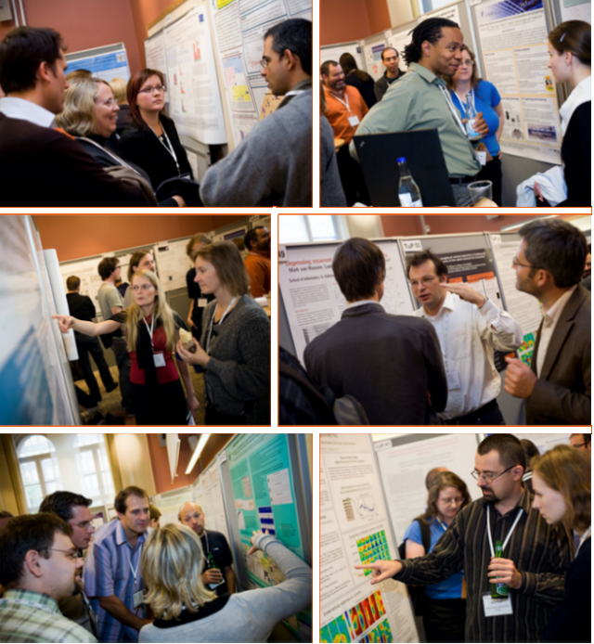
What is a Poster
Posters summarize information or research concisely and attractively to help publicize it and generate discussion
Poster is usually a mixture of a brief text mixed with tables, graphs, pictures, and other presentation formats.
Best medium to highlight what you have done and how you have done
One can present his/her work to large audience in Short Time
Interaction among creator and audience
Most conferences include poster presentations in their program
Source: Google Images - Neuroinformatics 2008 congress

Slide 15
Poster vs. Paper
A Poster Uses Visual Grammar. It shows, not tells. It expresses your points in graphical terms.
A poster is not just a standard research paper stuck to a board.
Provides an opportunity for more Q&A exchange between author and reader than a talk or paper
Allows one to convey more details than in a talk
All elements, even the figure legends, are visible from 4 feet away.
It displays the essential content rather than merely stating "results" and letting the viewer hunt for - or even worse, invent - the message.
It avoids visual chaos, with many jagged edges or various-sized boards that distract the viewer. Instead, it guides the viewer by using a visual logic, with an hierarchical structure that emphasizes the main points.

Slide 16
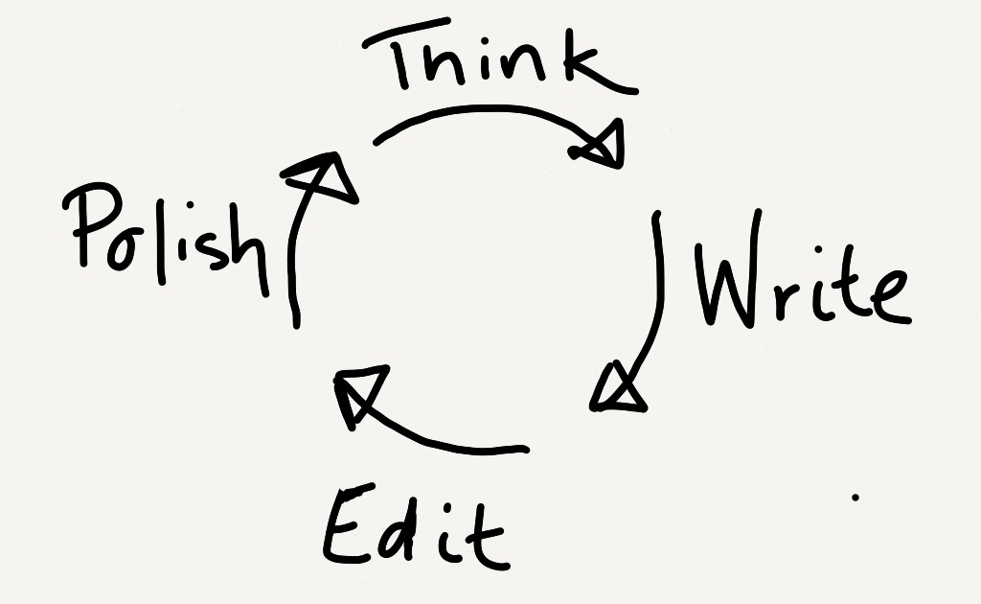
Writing a Good Research Paper

Slide 17

Know Your Journal

Slide 18

Know Your Audience
A Key To Success
Target Readers
Research Community etc.

Slide 19
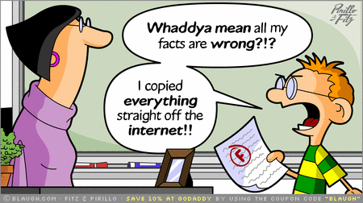

Plagiarism

Slide 20
Do`s and Do not`s
Do`s
Select a Suitable Research Topic
Specify the Focus of Your Research
Collect Relevant Data, Organize Carefully & Logically
Opinions and Claims Should be Supported by Facts
Captivating Conclusion
Edit and Proofread Your Research Paper
Correct and Appropriate Citations
Don`ts
Plagiarize
Lose Focus
Add Unnecessary Detail in Your Research
Add New Points in Your Conclusion
Forget To Provide The Correct Citations

Slide 21
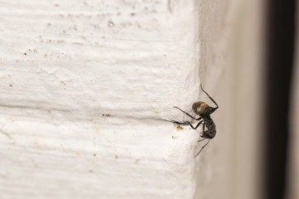

Try Try Again

Slide 22
Thank You & Questions

Slide 23
Sources
Pechenik, JA. 2007. A short guide to writing about biology, 6th ed. Pearson, Longman, NY.
NCHC Poster Guidelines. www.ucs.iastate.edu/mnet/ _repositroy/nchc/html/poster.htm. August 26, 2008.
Poster Preparation. www.kumc.edu/SAH/OTEd/ jradel/Poster_Presentations/120.html. August 26, 2008.
Abstracts, The Writing Center at Rensselaer Polytechnic Institute. www.rpi.edu/web/writingcenter/abstracts.html. August 26, 2008.
How to make a research poster using PowerPoint. Undergraduate Research, University of Missouri-Columbia. Undergradresearch.missouri.edu/resources/powerpoint-video.php. August 26, 2008.
http://askalibrarian.mwcc.edu/faq/85227
https://researchbasics.education.uconn.edu/wp ontent/uploads/sites/1215/2015/05/types.jpg

